Slide 1
objectives
i. Stacked and Cluster column chart properties
ii. 100% Stacked Bars
iii. Line chart and its properties
iiv. Area chart and stacked area charts
v. Pie and Donut charts
vi. Tables and Matrix/Crosstab reports
vi. Tables properties

Slide 2
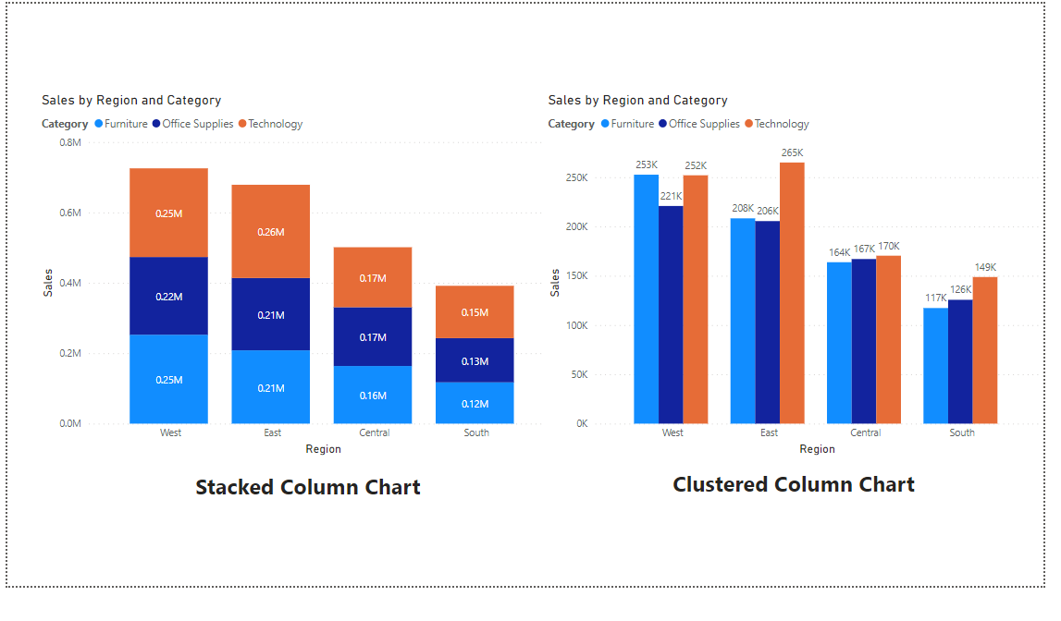
Stacked and cluster column chart properties

Slide 3
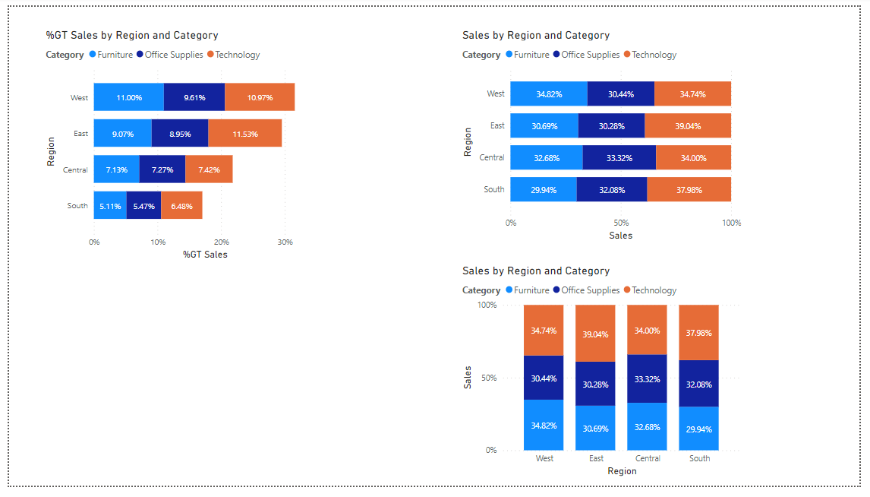
100% Stacked Bars

Slide 4
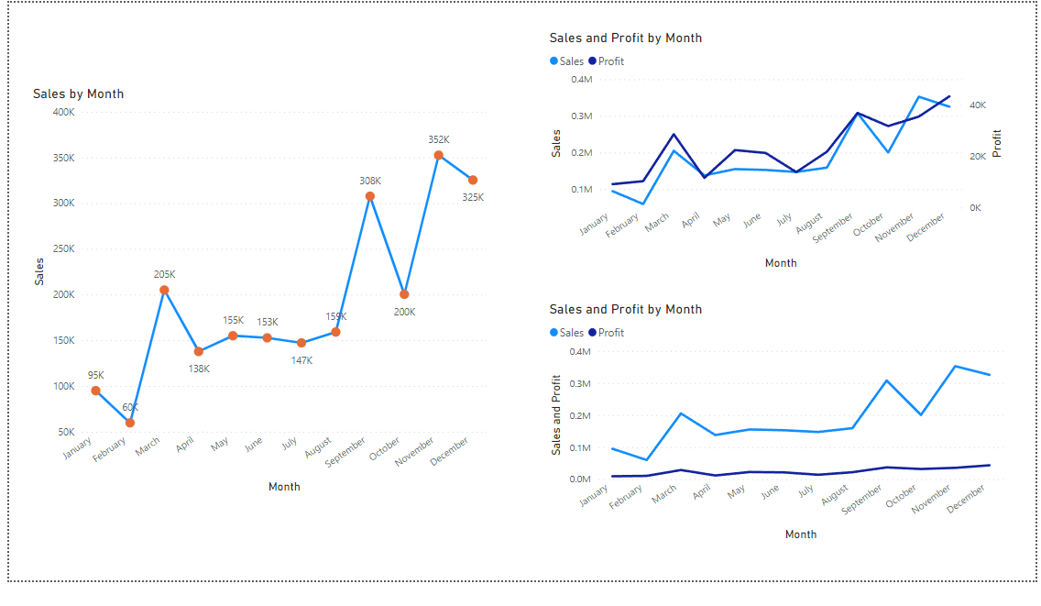
Line chart and its properties

Slide 5
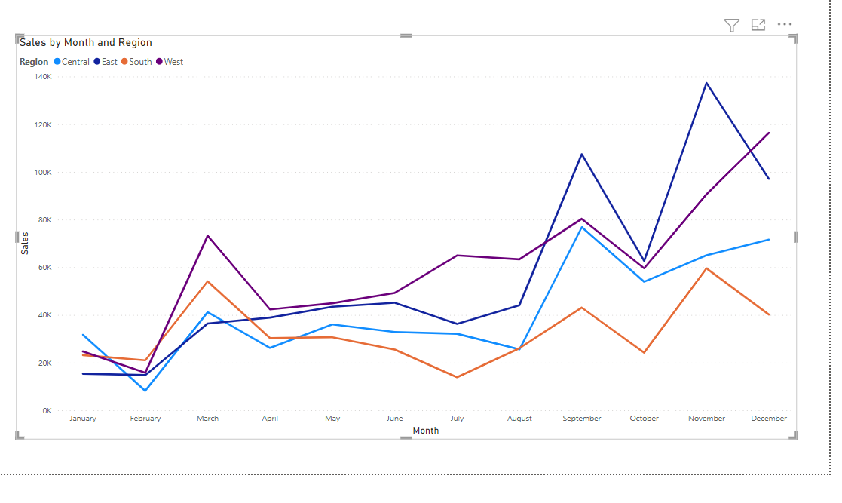
Line chart and its properties

Slide 6
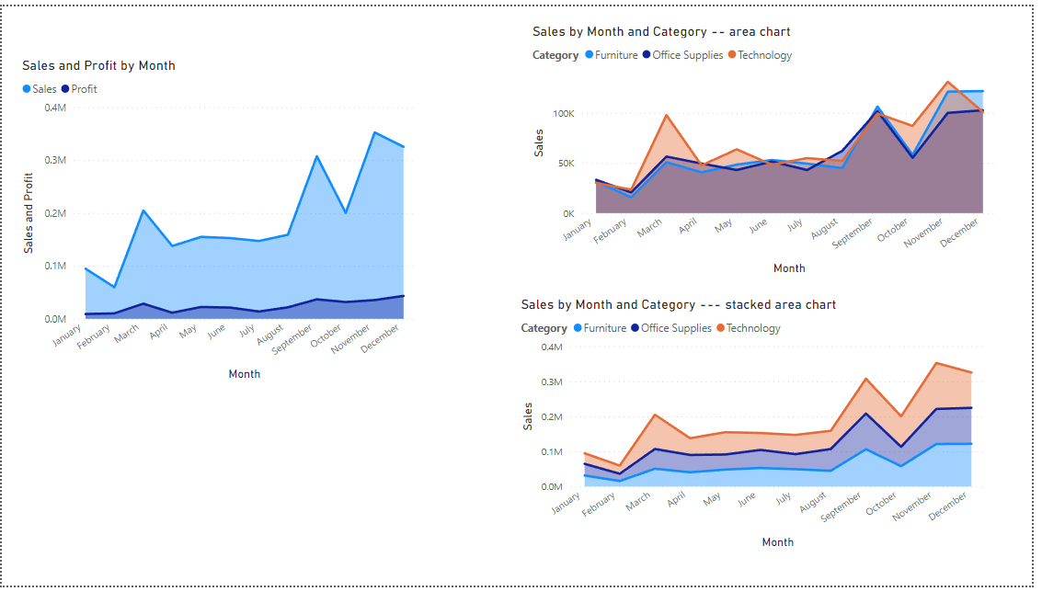
Area chart and stacked area charts

Slide 7
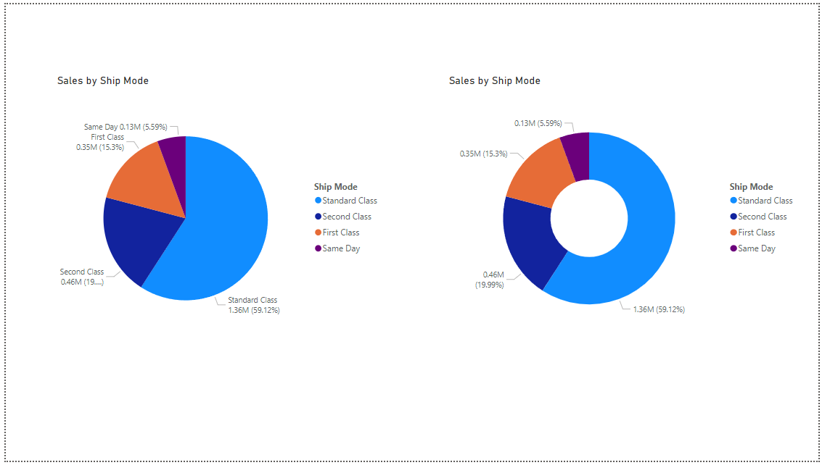
Pie and Donut charts

Slide 8
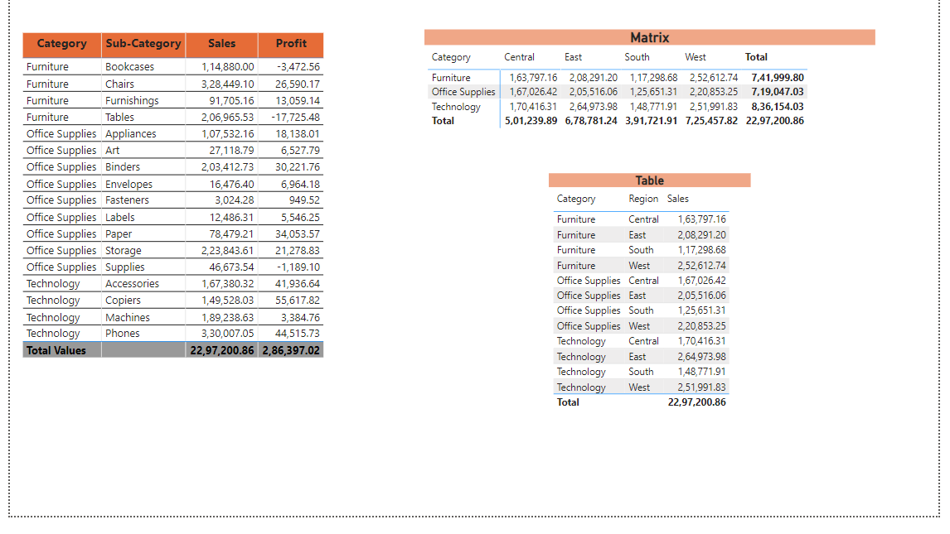
Tables and Matrix/Crosstab reports

Slide 9
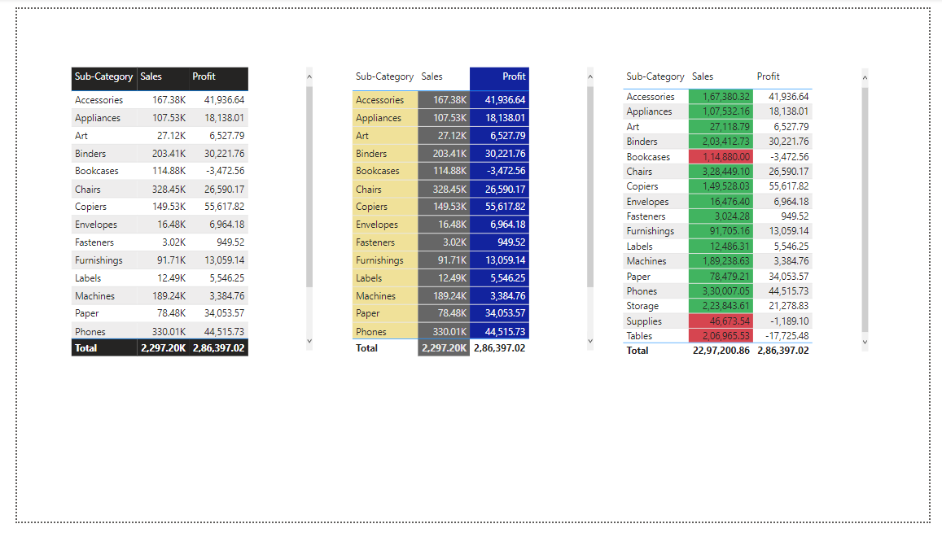
Tables properties

